Slide 1

Creating Prosperity
Through
Economic Freedom

Slide 2
Why Economic Freedom is Important
Background

Slide 3
Components of the Economic Freedom of the World Index
Size of government and taxation
Private property and the rule of law
Sound money
Trade regulation and tariffs
Regulation of business, labour and capital markets

Slide 4
What is the Economic Freedom of the World Index?
An annual compilation of data representing factors which make a country economically free.
Launched with a decade long research project in the mid-1980s, led by then Fraser Executive Director Michael Walker and Milton and Rose Friedman with active participation of Walter Block and Alvin Rabushka
Authors: James Gwartney, Robert Lawson, Joshua Hall, and Ryan Murphy.
A compendium of 42 government policies affecting economic freedom based on objective data or independent surveys.
The survey includes a Gender Disparity Adjustment variable to recognize that women too often do not have the same level of freedom as men.
A ranking of 161 countries plus Hong Kong, representing 95% of the world’s population, according to the extent to which they permit their citizens to be economically free.
Now a collaboration of Institutes in nearly 100 nations and territories.

Slide 5
Why is Economic Freedom Important?
Economic rights are fundamental rights in the sense that without them there can be no political freedom or civil freedoms
They are a prerequisite for growth and development
They are a prerequisite for broader human development

Slide 6
Economic Freedom Benefits in the Real World
The Impact of
Economic Freedom

Slide 7
The Age of
Global Free Trade,
Free Market Economies, and Economic Freedom
Have Brought
Huge Benefits to Humankind

Slide 8
The human condition
has improved immensely
But the gains were most achieved by those living in economically free areas

Slide 9
Escape from
Global poverty
Billions

Slide 10
Extreme poverty headcount ratio at $2.15 a day
(2017 PPP) (% of population)
Least Free ……………. Most Free

Slide 11
Income of the Poorest 10% and Economic Freedom
(PPP)
Least Free ……………. Most Free

Slide 12
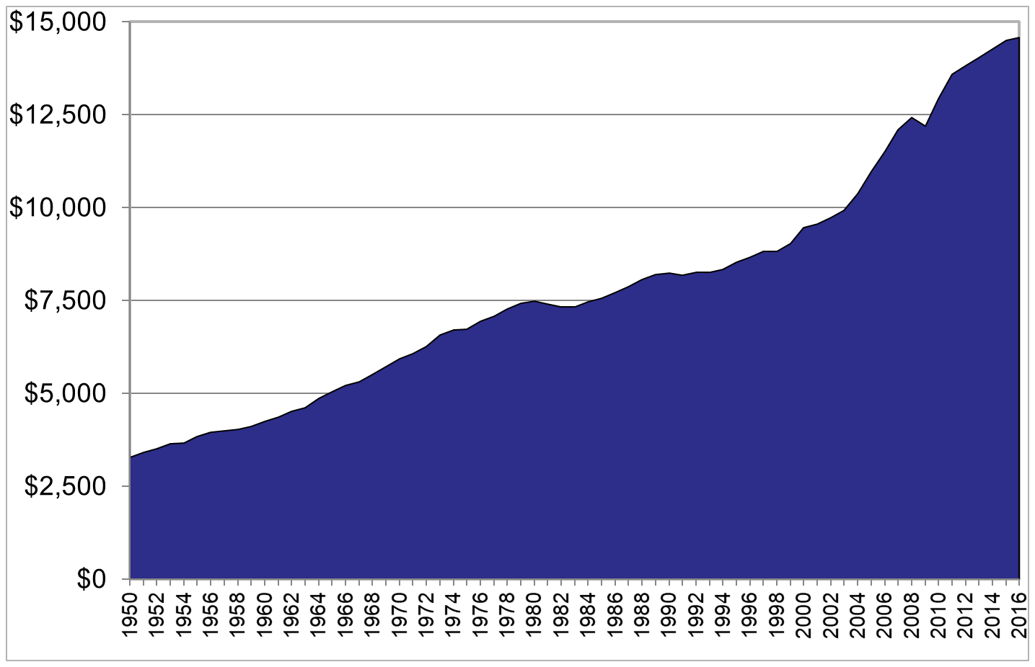
Global Per capita GDP
Constant US$

Slide 13
Per Capita Income and Economic Freedom Quartile
Least Free ……………. Most Free

Slide 14
Literacy: Billions
Billions

Slide 15
Literacy (% of population)
Male Female
Least Free ……………. Most Free
Sources: The Fraser Institute; World Development Indicators 2013

Slide 16
Life Expectancy: Years

Slide 17
Life expectancy at birth
Least Free ……………. Most Free
Notes:
17

Slide 18
Not just due to time
Economically Free Jurisdictions have Gained the Greatest Benefits

Slide 19
Not just due to time: 2
For Example
In the economically freest nations, the top quarter, less than 1% of the population live in extreme poverty ($2.15 a day) compared to 32% in extreme poverty in the quarter least free nations.
In the freest nations, the average income of the poorest 10% is $14,091 (purchasing power parity adjusted US$) annually compared to $1,736 in the least free nations.
Average per capita GDP in the freest nations is $48,569 compared to $6,324 in the least free nations.
Life expectancy is 81 years in the freest nations compared to 65 in the least free nations.

Slide 20
A couple last things:
Economic freedom promotes democracy and other freedoms.
It even increases happiness.
Freedom gives people control over their own lives, an essential element of happiness.

Slide 21
Political and Civil Rights
0 – 10 scale
Least Free ……………. Most Free

Slide 22
Economic Freedom and
Life Satisfaction/Happiness
Least Free ……………. Most Free

Slide 23
The longer-term success of economically free nations
To continue strong growth,
increased economic freedom is needed
Rocket Nations

Slide 24
Asia: Economic Freedom

Slide 25
Per Capita GDP: Constant 2015 US$

Slide 26
Western Europe and Ireland

Slide 27
Per Capita GDP

Slide 28
Sub-Sahara Africa

Slide 29
Per Capita GDP

Slide 30
South America

Slide 31
Per capita GDP

Slide 32
Thank you!
All data and publications available for free at: www.fraserinstitute.org

