Slide 1

How Economic Freedom
Creates a Better World for Everyone
Fred McMahon
Michael Walker Chair
Economic Freedom Research
The Fraser Institute

Slide 2
What do we mean by
Economic Freedom
People are economically free when the laws and legislation of states in which they reside or trade:
Refrain from: Restricting their rights to work, to barter, to trade, and to invest
Refrain from: Heavily taxing these undertakings and their results
Refrain from: Expropriating their property
Refrain from: Excessive expansion of the Money Supply and the related destruction of purchasing power
But:
Actively promote the rule of law
Actively protect the right to create and own property
Actively protect the security of persons and property

Slide 3
How can we measure
Freedom?
Since freedom means government refraining from intervening in our lives, we can measure the loss of freedom by measuring the extent to which governments intervene in our lives.
Since freedom means that governments must actively protect us from some actions by others, we can measure the loss of freedom by their failure to provide that protection.

Slide 4
What is the Economic Freedom of the World Index?
An annual compilation of data representing factors which make a country economically free.
Launched with a decade long research project in the mid-1980s, led by then Fraser Executive Director Michael Walker and Milton and Rose Friedman with active participation of Walter Block and Alvin Rabushka
Authors: James Gwartney, Robert Lawson, Joshua Hall, and Ryan Murphy.
A compendium of 42 government policies affecting economic freedom based on objective data or independent surveys.
The survey includes a Gender Disparity Adjustment variable to recognize that women too often do not have the same level of freedom as men.
A ranking of 161 countries plus Hong Kong, representing 95% of the world’s population, according to the extent to which they permit their citizens to be economically free.
Now a collaboration of Institutes in nearly 100 nations and territories.

Slide 5
Components of the Economic Freedom of the World Index
Size of government and taxation
Private property and the rule of law
Sound money
Trade regulation and tariffs
Regulation of business, labour and capital markets

Slide 6
Why is Economic Freedom Important?
Economic rights are fundamental rights in the sense that without them there can be no political freedom or civil freedoms
They are a prerequisite for growth and development
They are a prerequisite for broader human development

Slide 7
Reflections on the Obvious

Slide 8
The Age of
Global Free Trade,
Free Market Economies, and Economic Freedom
Have Brought
Huge Benefits to Humankind

Slide 9
The human condition
has improved immensely
But the gains were most achieved by those living in economically free areas

Slide 10
Escape from
Global poverty
Billions

Slide 11
Extreme poverty headcount ratio at $1.90 a day
(PPP) (% of population)
Least Free ……………. Most Free

Slide 12
Income of the Poorest 10% and Economic Freedom
(PPP)
Least Free ……………. Most Free

Slide 13
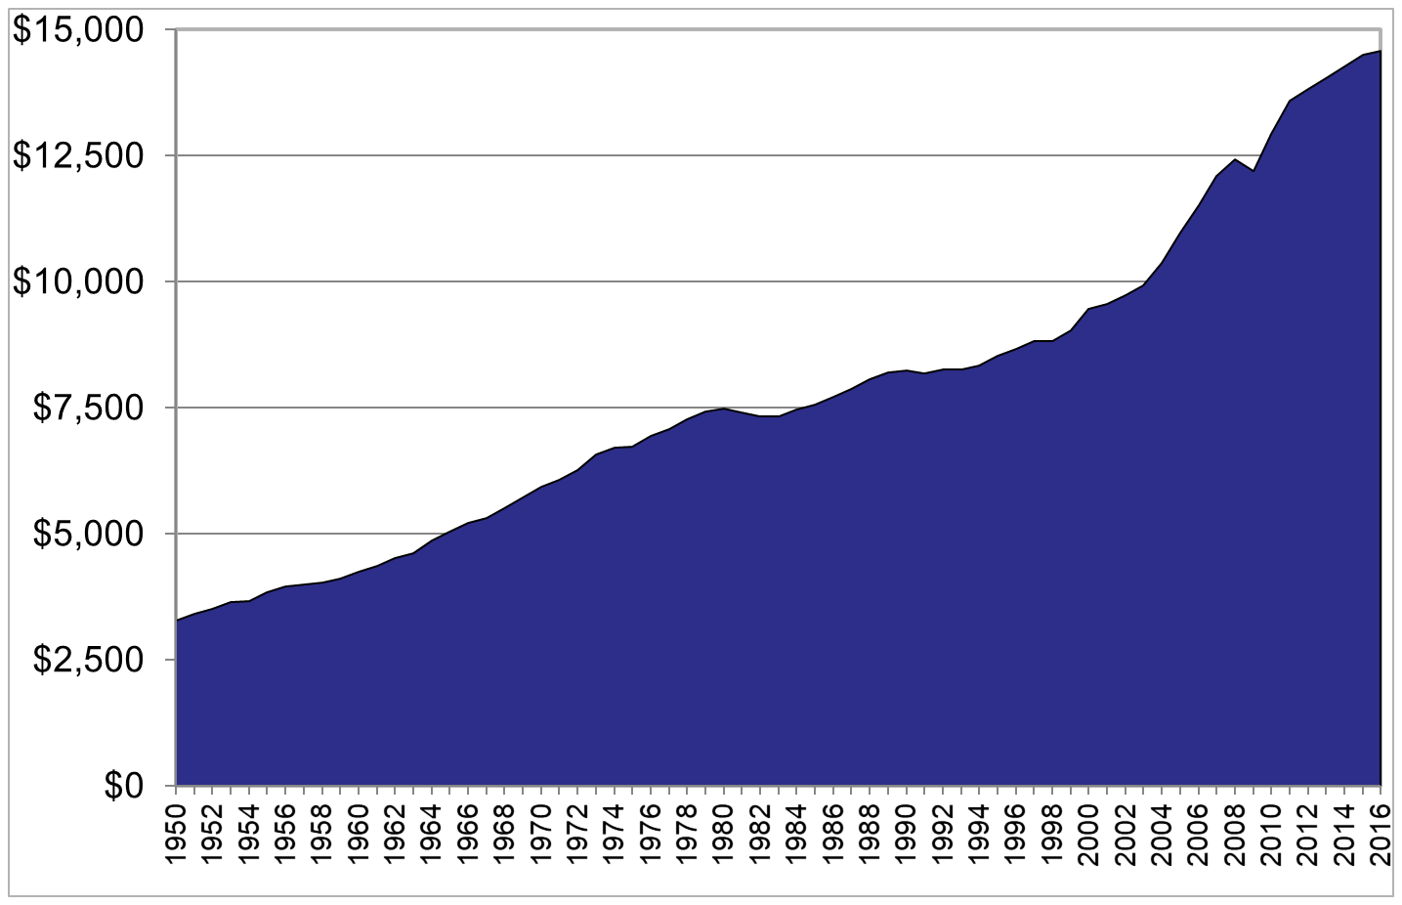
Global Per capita GDP
Constant US$

Slide 14
Per Capita Income and Economic Freedom Quartile
Least Free ……………. Most Free

Slide 15
Literacy: Billions
Billions

Slide 16
Literacy (% of population)
Male Female
Least Free ……………. Most Free
Sources: The Fraser Institute; World Development Indicators 2013

Slide 17
Life Expectancy: Years

Slide 18
Life expectancy at birth
Least Free ……………. Most Free
Notes:
18

Slide 19
Not just due to time
In the economically freest nations, the top quarter, only 0.94% of the population live in extreme poverty ($1.90 a day) compared to 3410% in extreme poverty in the quarter least free nations.
Life expectancy is 81.1 years in the freest nations compared to 65.9 in the least free nations.
Average per capita GDP in the freest nations is $50,619 (purchasing power parity adjusted US$) compared to $5,911 in the least free nations.
Literacy is 95.1% among men and 94.1% among women in the freest nations but only 64.7% and 59.7% respectively in the least free nations. Outcome gaps between men and women are typical in unfree nations.

Slide 20
A couple last things

Slide 21
Political and Civil Rights
0 – 10 scale
Least Free ……………. Most Free

Slide 22
Economic Freedom and
Life Satisfaction/Happiness
Least Free ……………. Most Free

Slide 23
Evolution of Economic Freedom over Time

Slide 24
Average Global Scores

Slide 25
Regional Evolution

Slide 26
Things had been getting better
Will that continue?

Slide 27
Thank you. www.fraserinstitute.org

