Slide 1
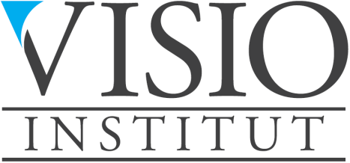
Economic Freedom of the World
Release Presentation
September 15, 2016

Slide 2
What is the Economic Freedom of the World Index?
An annual compilation of data representing factors which make a country economically free
Authors: James Gwartney, Robert Lawson, and Joshua Hall
A compendium of 42 government policies affecting economic freedom based on objective data or independent surveys
A ranking of 156 countries plus Hong Kong, representing 95% of the world’s population, according to the extent to which they permit their citizens to be economically free
Now a collaboration of Institutes in 90 nations and territories

Slide 3
What is Economic Freedom
Individuals have economic freedom when property they acquire without the use of force, fraud, or theft is protected from physical invasions by others and they are free to use, exchange, or give their property as long as their actions do not violate the identical rights of others. An index of economic freedom should measure the extent to which rightly acquired property is protected and individuals are engaged in voluntary transactions.
James Gwartney et al. 1996

Slide 4
Components of the Economic Freedom of the World Index
Size of government and taxation
Private property and the rule of law
Sound money
Trade regulation and tariffs
Regulation of business, labour and capital markets

Slide 5
Talk about making a difference …

Slide 6
Member Institutes of Economic Freedom of The World Network
Afghanistan Economic and Legal Studies Organization (AELSO), Afghanistan
Albanian Center for Economic Research (ACER), Albania
Fundación Libertad, Argentina
Centre of Political, Legal and Economic Researches and Forecasting (PLERF), Armenia
Institute of Public Affairs, Australia
TIGRA®, Austria
Center for Economic and Political Research, Azerbaijan
The Nassau Institute, Bahamas
Making Our Economy Right (MOER), Bangladesh
Scientific Research Mises Center, Belarus
Centre for the New Europe, Belgium
Politicas Publicas para la Libertad (POPULI), Bolivia
Instituto Liberal do Rio de Janeiro, Brazil
Institute for Market Economics, Bulgaria
Le Centre des Affaires Humaines (CEDAH), Burkina Faso
The Cambodia Institute of Development Study, Cambodia
Instituto Libertad y Desarrollo, Chile
Center for China & Globalization, China
Instituto de Ciencia Politica, Colombia
Instituto para la Libertad y el Análisis de Políticas, Costa Rica
Audace Institut Afrique, Côte d’Ivoire
The Institute of Economics, Croatia
Liberální Institut, Czech Republic
Center for Politiske Studier (CEPOS), Denmark
Fundación Economía y Desarrollo Inc, Dominican Republic
Instituto Ecuatoriano de Economía Política, Ecuador
Institut Economique Molinari, France
Society for Disseminating Economic Knowledge: New Economic School, Georgia
Liberales Institut, Germany
The Institute of Economic Affairs, Ghana
Centro de Investigaciones Económicas Nacionales, Guatemala
InafEcon-Institute of African Economics, Guinea
Institut de Recherche pour la Liberté Economique et la Prospérité (IRLEP), Haiti
Centro de Investigaciones Economicas y Sociales (CIES), Honduras
Hong Kong Centre for Economic Research, Hong Kong
Szazadveg Foundation, Hungary
Centre for Social and Economic Research (RSE), Iceland
Centre for Civil Society, India
The Institute for Development of Economics and Finance, Indonesia
Open Republic Institute, Ireland
Jerusalem Institute for Market Studies, Israel
Centro Einaudi, Italy
Young Entrepreneurs Association, Jordan
Central Asian Free Market Institute, Kazakhstan
African Research Center for Public Policy and Market Process, Kenya
Center for Free Enterprise, Korea
Group for Legal and Political Studies, Kosovo
Economic Policy Institute-Bishkek Consensus, Kyrgyz Republic
Lithuanian Free Market Institute, Lithuania
D'Letzeburger Land, Luxembourg
Institute for Democracy and Economic Affairs (IDEAS), Malaysia
Centro de Investigación para el Desarrollo A.C., Mexico
Open Society Forum, Mongolia
The Center for Entrepreneurship and Economic Development, Montenegro
The Prosperity Foundation, Nepal
The New Zealand Business Roundtable, New Zealand
Initiative for Public Policy Analysis, Nigeria
Center for Business and Society Incorporated (Civita), Norway
International Research Foundation (IRF), Oman
Alternate Solutions Institute, Pakistan
Pal-Think for Strategic Studies, Palestine
Fundación Libertad, Panama
Centro de Investigación y Estudios Legales (CITEL), Peru
The Center for Research and Communication, Philippines
Centrum im. Adama Smitha, Poland
Causa Liberal, Portugal
Romania Think Tank, Romania
Institute of Economic Analysis, Russia
Free Market Center (FMC), Serbia
The F.A. Hayek Foundation, Slovak Republic
The Free Market Foundation of Southern Africa, South Africa
Fundacio Catalunya, Spain
Pathfinder Foundation, Sri Lanka
Nile Institute of Economic Studies, Sudan
Timbro, Sweden
Liberales Institut, Switzerland
Tajikistan Free Market Centre, Tajikistan
Arthur Lok Jack Graduate School of Business, The University of the West Indies, Trinidad and Tobago
Association for Liberal Thinking, Turkey
The Ukrainian Center for Independent Political Research, Ukraine
The Institute of Economic Affairs (IEA), United Kingdom
CATO Institute, USA
The Centre for the Dissemination of Economic Knowledge (CEDICE), Venezuela
Research Center for Entrepreneurship Development, Vietnam
Zambia Institute for Public Policy Analysis (ZIPPA), Zambia

Slide 7
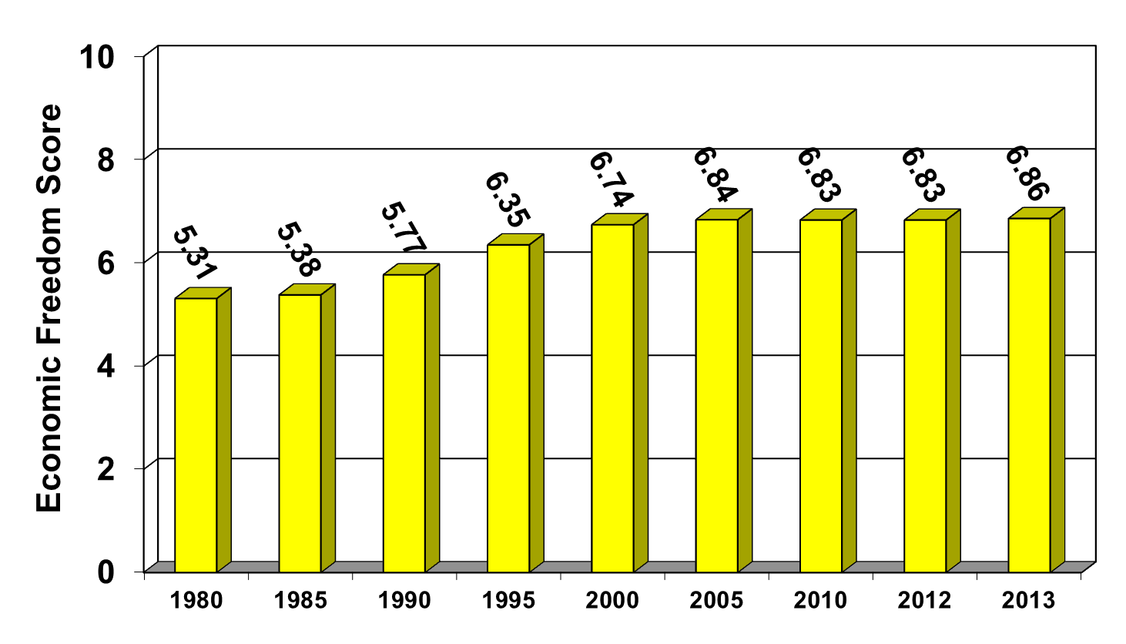
World Average
Economic Freedom Over Time
Source: The Fraser Institute.

Slide 8
Why is Economic Freedom Important?
Economic rights are fundamental rights in the sense that without them there can be no political freedom or civil freedoms
They are a prerequisite for growth and development
They are a prerequisite for broader human development

Slide 9
The impact on prosperity and development

Slide 10
Per Capita Income and Economic Freedom Quartile
Most Free ……………. Least Free
Sources: The Fraser Institute; The World Bank, World Development Indicators, 2013

Slide 11
Economic Freedom, the Poor, and
Inequality

Slide 12
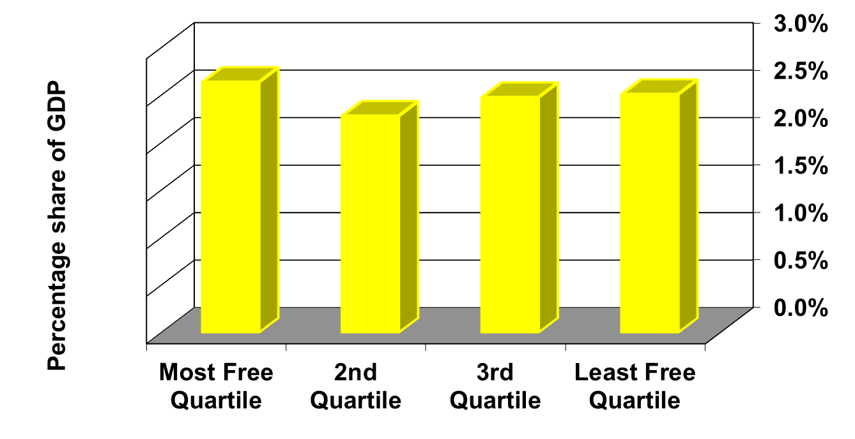
Income Share of the Poorest 10% and Economic Freedom
Most Free ……………. Least Free
Sources: The Fraser Institute; The World Bank, World Development Indicators, 2013.

Slide 13
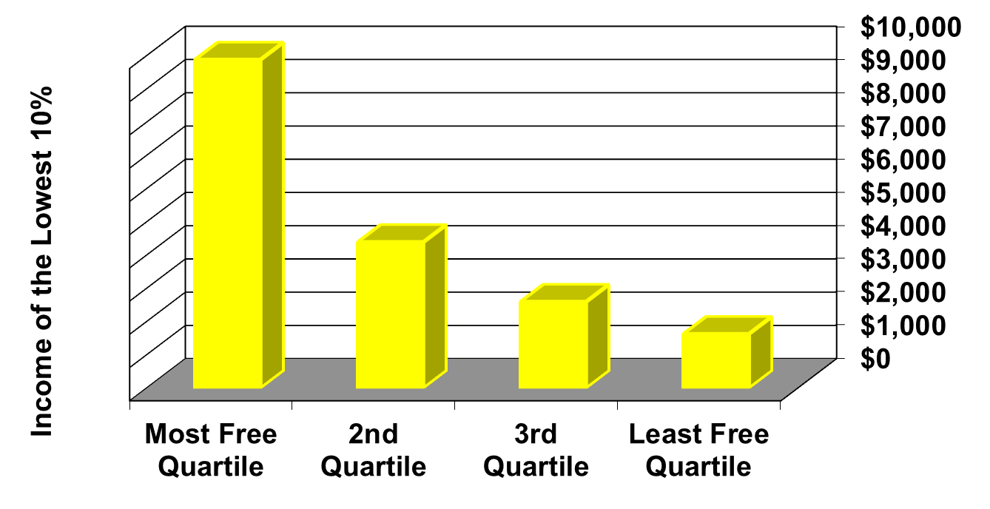
Income of the Poorest 10% and Economic Freedom
Most Free ……………. Least Free
Sources: The Fraser Institute; The World Bank, World Development Indicators, 2013.

Slide 14
Economic Freedom, Governance, and Democracy

Slide 15
Economic Freedom and Political Rights
Most Free ……………. Least Free
Sources: The Fraser Institute; Freedom House, Freedom in the World Country Ratings, 2012, available at http://www.freedomhouse.org/.

Slide 16
Economic Freedom and Civil Rights
Most Free ……………. Least Free
Sources: The Fraser Institute; Freedom House, Freedom in the World Country Ratings, 2012, available at http://www.freedomhouse.org/.
Notes:
16

Slide 17
The impact of Economic Freedom on other indicators of well-being

Slide 18
Economic Freedom and Corruption
High scores indicate low corruption
Most Free ……………. Least Free
Sources: The Fraser Institute; Transparency International, Corruption Perceptions Index, 2014 available at http://www.transparency.org.

Slide 19
Economic Freedom and
Life Satisfaction
Most Free ……………. Least Free
Sources: The Fraser Institute; Happy Planet Index 2014

Slide 20
Life Expectancy at Birth and Economic Freedom Quartiles
Most Free ……………. Least Free
Sources: The Fraser Institute; The World Bank, World Development Indicators, 2013.

Slide 21
Literacy (% of population)
Male Female
Most Free ……………. Least Free
Sources: The Fraser Institute; World Development Indicators 2013

Slide 22
Economic Freedom Audits
Slovenia
Venezuela
Nepal
Kyrgyz Republic
Oman
Jordan
Tunisia
Lebanon
Malaysia
Côte d'Ivoire
Central America
Egypt
Upcoming
Greece
Turkey
Serbia
Uruguay

Slide 23
Some of the great longer-term successes

Slide 24
Economic Freedom

Slide 25
Per Capital GDP
Free Market Reform

Slide 26
Asia
Economic Freedom Scores

Slide 27
Per Capital GDP

Slide 28
Sub-Sahara Africa
Economic Freedom Scores

Slide 29
Per Capital GDP

Slide 30
Zambia:
Economic Freedom

Slide 31
Zambia: Per capita GDP

Slide 32
Economic Freedom
Increases prosperity for all
Reduces poverty
Increases other freedoms
Improves quality of life

Slide 33
www.freetheworld.com www.fraserinstitute.org

